Slide 1
Reproducibility in built environment datasets: An integrated Analysis
Abeoseh Flemister
Ivory Blakley
Shan Sun
Anthony Fodor

Slide 2
Aims
Determine reproducibility in the human hand microbiome vs floor microbiome
Determine reproducibility in hand associated microbiome vs floor associated microbiome
Determine if DEBIAS-M batch correction algorithm improves correlation
Impact: determine cross site reproducibility to allow for interventions which work across a multitude of built environments

Slide 3
Our workflow to determine reproducibility across datasets
P-value vs p-value plots
LOSO Random Forest with 100 permutations
ROC curves
Qitta based literature search
Merge Datasets by ontology
Log normalization
DEBIAS-M for batch correction
LOO Random Forest with 100 permutations
Notes:
We first started with a Qitta based literature search, Qitta is a database of count tables

Slide 4
Study Information
Study ID | Author | Location | Count | Seq Depth
10172 | Lax et al. 2017 | Hospital | 1253 | Rarefied to 5000
12470 | Richardson et al. 2019 | Dorm | 194 | Rarefied 4000 (counts/sample
11740* | Sharma et al. 2019 | Air Force | 94 | average of 7,372 reads per sample
2192* | Lax et al. 2014 | House | 32 | Rarefied to 100
* Longitudinal observational studies
11740
I selected the first collection timepoint for (2016-08-15 09:00)
2192
18 participants at 7 houses with two floor sampling areas (bathroom and kitchen)
18+(7*2)=32 total samples
Notes:
- We have studies from a diverse range of built environments
We also have a large range in counts and diversity in sequencing depth, so we also explored batch correction to determine if we could increase reproducibility
Lax et al. 2014 has the lowest count and seq depth, this is the one that didn’t reproduce.
2192 house breakdown:
House Inhabitants
1 4
2 1
3 3
4 3
5 2
6 3
7 2

Slide 5
Our workflow to determine reproducibility across datasets
P-value vs p-value plots
LOSO Random Forest with 100 permutations
ROC curves
Qitta based literature search
Merge Datasets by ontology
Log normalization
DEBIAS-M for batch correction
LOO Random Forest with 100 permutations

Slide 6
Human Hand vs Floor ontology
Study | Name | Common Name
Lax et al. 2017: Hospital | skin | Human Hand
Lax et al. 2017: Hospital | Floor, Corridor Floor, | Environmental (Floor)
Sharma et al. 2019: Air Force | skin | Human Hand
Sharma et al. 2019: Air Force | Doorstop, floor corner, squad common room | Environmental (Floor)
Richardson et al. 2019: Dorm | Hand | Human Hand
Richardson et al. 2019: Dorm | Floor, hallway | Environmental (Floor)
Lax et al. 2014: House | hand | Human Hand
Lax et al. 2014: House | Bathroom floor, bedroom floor, kitchen floor | Environmental (Floor)

Slide 7
Our workflow to determine reproducibility across datasets
P-value vs p-value plots
LOO Random Forest with 100 permutations
ROC curves
Qitta based literature search
Merge Datasets by ontology
Log normalization
DEBIAS-M for batch correction
LOO Random Forest with 100 permutations

Slide 8
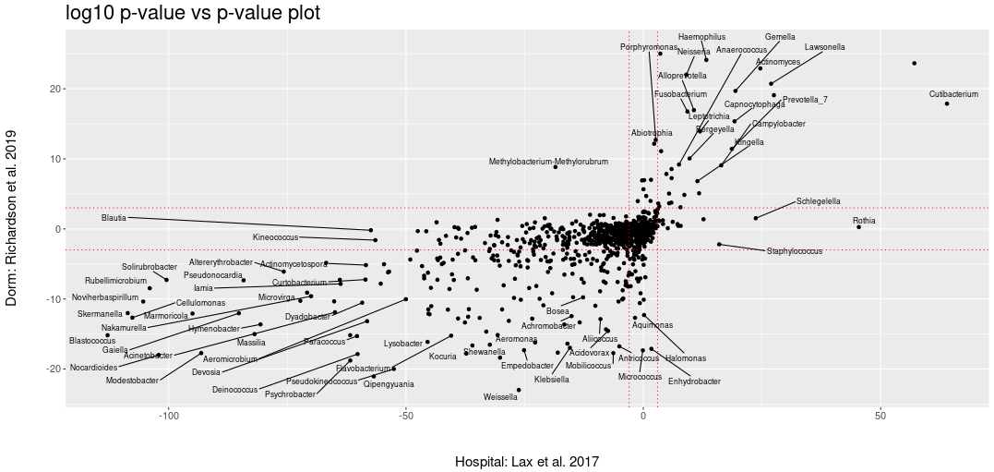
Example: Studies comparing human-hand vs floor show strong agreement across most taxa
Higher in hand
Higher in floor
Higher in floor
Higher in hand
Notes:
Pval-pval
In quads with disagreement there are virtually no taxa which shows strong agreement
For a given bacteria:
Calculate the mean of floor and hand counts
Preform a Wilcoxon between hand and floor samples
Weighted the p-values from the Wilcoxon as negative if mean was higher in floor samples and positive if it was higher in hand samples
Q1 agreement, higher in hand
Q3 agreement, higher in floor

Slide 9
Our workflow to determine reproducibility across datasets
P-value vs p-value plots
LOSO Random Forest with 100 permutations
ROC curves
Qitta based literature search
Merge Datasets by ontology
Log normalization
DEBIAS-M for batch correction
Random Forest with 100 permutations
LOSO = leave one study out
Notes:
We also did random forest (a classification algorithm) with 100 permutations with and without batch correction
A permutation is when you randomize the labels, in our case, hand and floor to break up the structure and associated meaning in the data
This allows us to test if our actual signal is stronger than noise

Slide 10
Human Hand vs Floor
Notes:
- We expected hand vs floor to reproduce

Slide 11
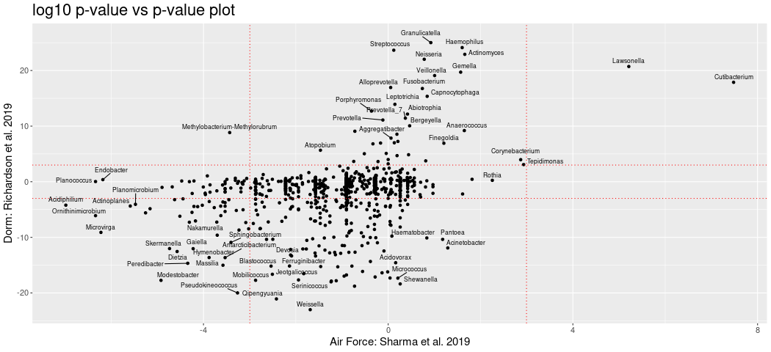
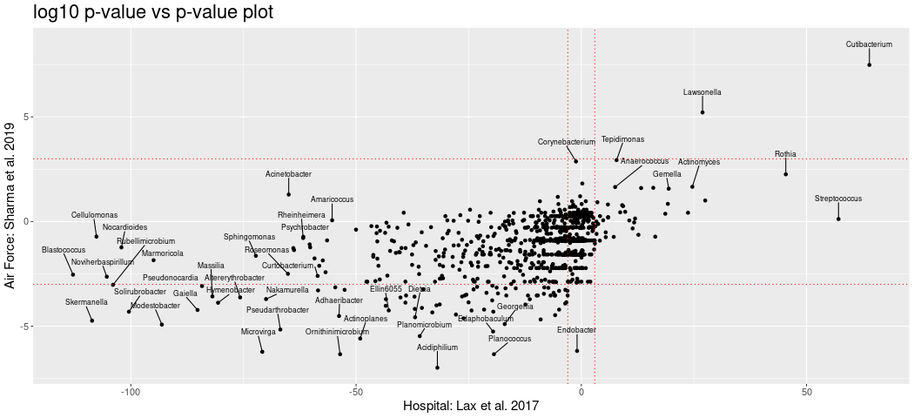
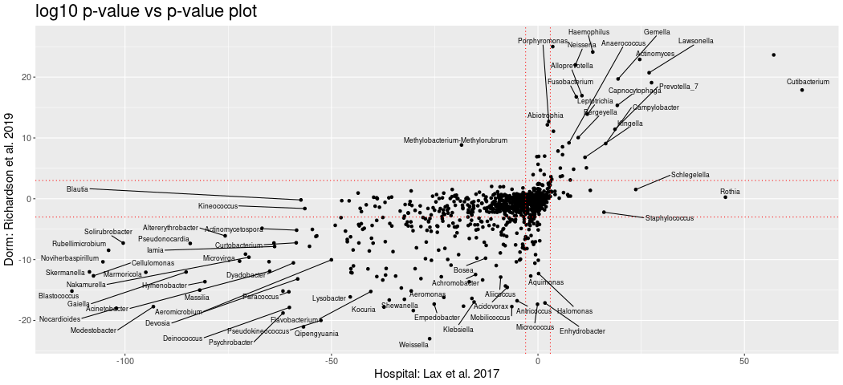
Reproducibility is observed across multiple taxa in 3 datasets
Notes:
We saw fairly high agreement between studies
Interestingly, between studies, there were soil bacteria that were higher in floor samples floor, which can inform later analyses
skermonella, Cellulomonas (cell-u-low-mass), Solirubrobacter (sol-i-row-bro-bacter), *Sphingobacterium (spa-ing-oh-bacterium)
Although Sphingobacterium (spa-ing-oh-bacterium) (on plot 1) is predominately found in soil, it also been found in moist areas of hospitals and can opportunistic infections
1 https://www.sciencedirect.com/topics/agricultural-and-biological-sciences/sphingobacterium#:~:text=The%20genera%20Chryseobacterium%2C%20Myroides%2C%20Empedobacter,in%20moist%20areas%20within%20hospitals.
2 https://www.microbiologyresearch.org/content/journal/ijsem/10.1099/ijsem.0.003944
3 https://www.sciencedirect.com/topics/immunology-and-microbiology/Cellulomonas
4 https://www.frontiersin.org/journals/microbiology/articles/10.3389/fmicb.2023.1267771/full

Slide 12
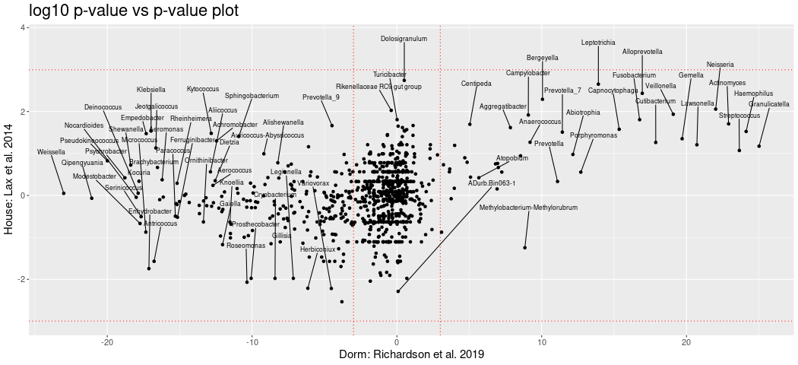
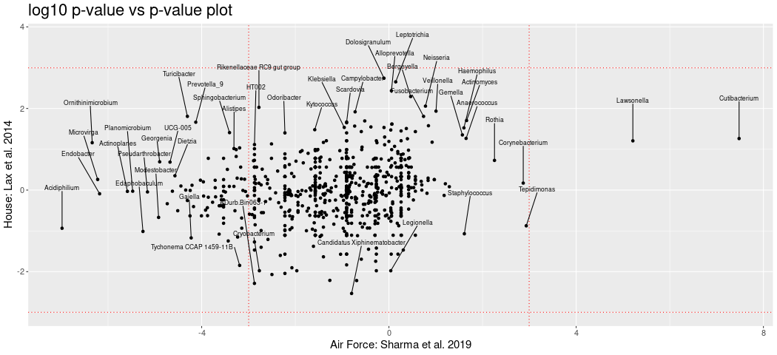
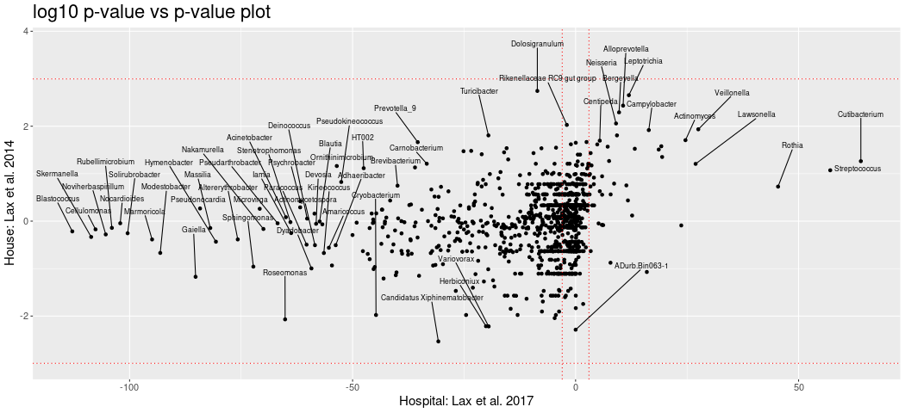
Dataset with smallest sample size does not show strong reproducibility
Notes:
Now, between studies, we have one bacteria in common between hand samples, Lawsonella a pathogenic bacteria
https://pmc.ncbi.nlm.nih.gov/articles/PMC9992747/

Slide 13
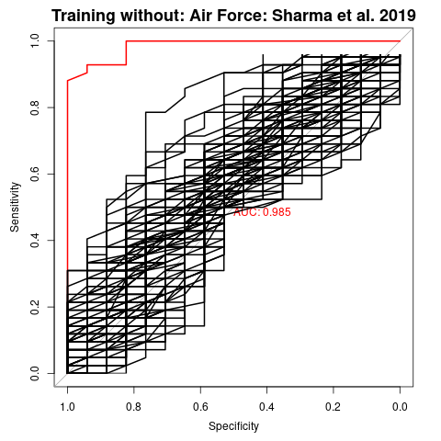
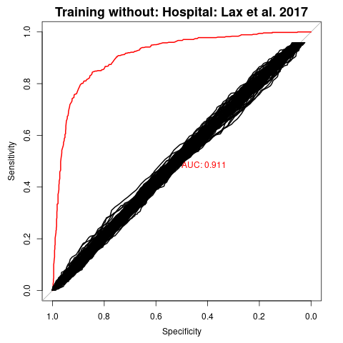
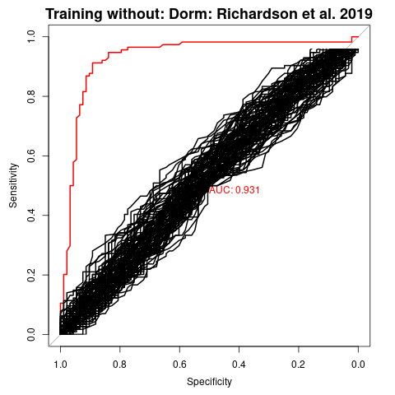
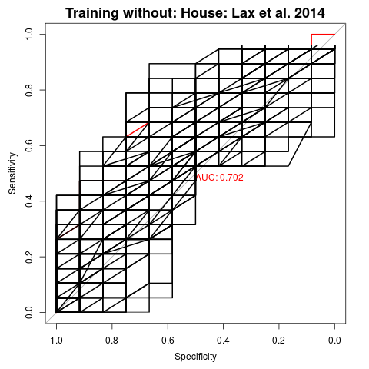
For hand vs floor, three out of four samples showed strong reproducibility, in leave one study out design
Notes:
- The p-value/p-value plots are mirrored in the ROC curves, Lax et. al, 2014 which didn’t have any bacteria in common with other studies also preformed much worst

Slide 14
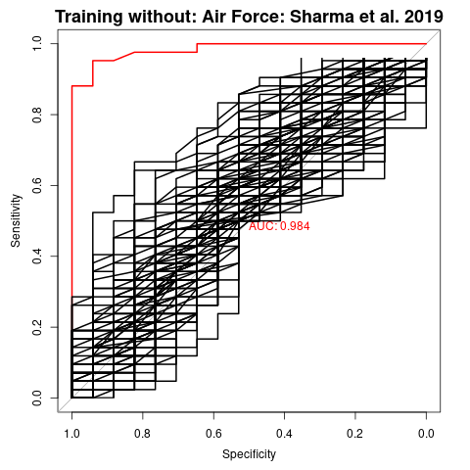
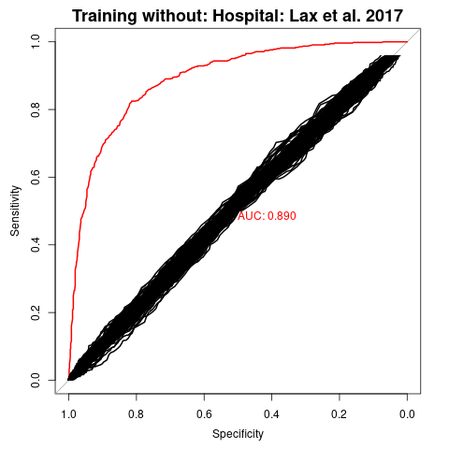
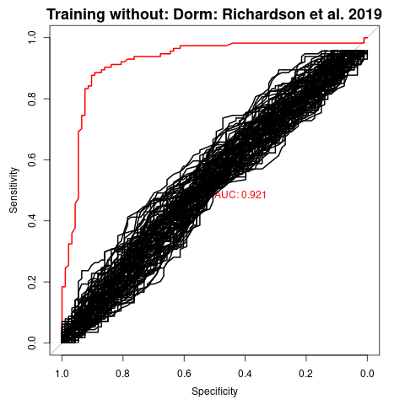
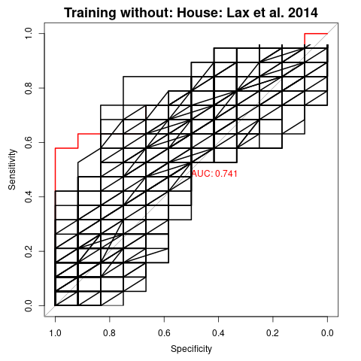
Batch correction does not improve reproducibility
Notes:
- There was not large correction after batch correction

Slide 15
Hand vs floor associated
Notes:
** point out that associated preformed better than expected

Slide 16
Hand associated vs Floor associated ontology
Study | Name | Common Name
Lax et al. 2017: Hospital | cold tap faucet handle, bedrail, countertop, computer mouse, station phone, chair armrest, hand, personal cell phone, hospital pager, hot tap water faucet handle, cold tap water faucet handle | Skin (Hand) Associated
Lax et al. 2017: Hospital | floor, corridor floor, shoe | Environment (floor) Associated
Sharma et al. 2019: Air Force | desk, skin | Skin (Hand) Associated
Sharma et al. 2019: Air Force | common room, bathroom handle, doorstop, floor corner, squad common room | Environment (floor) Associated
Richardson et al. 2019: Dorm | desk, door handle, hand, elevator button, main door, table | Skin (Hand) Associated
Richardson et al. 2019: Dorm | shoe, floor, hallway | Environment (floor) Associated
Lax et al. 2014: House | Bathroom doorknob, front doorknob, hand, kitchen counter, kitchen light switch, | Skin (Hand) Associated
Lax et al. 2014: House | bedroom floor, foot, kitchen floor, dog foot, cat paw | Environment (floor) Associated

Slide 17
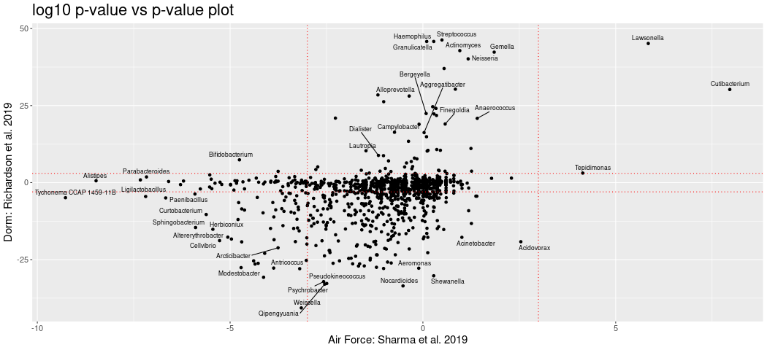
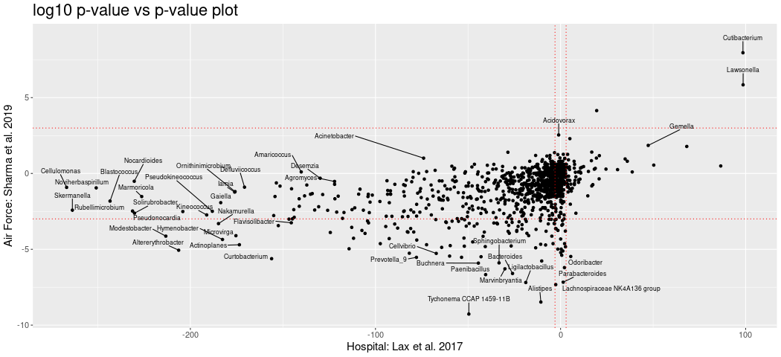
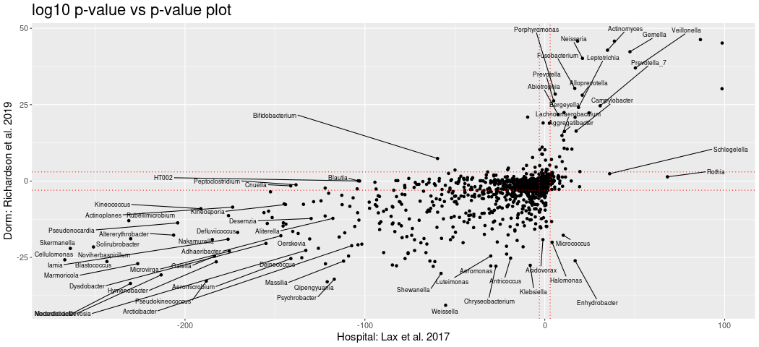
Reproducibility is observed across multiple taxa in 3 datasets
Notes:
We saw fairly high agreement between studies
Interestingly, between studies, there were soil bacteria that were higher in floor samples floor, which can inform later analyses
skermonella, Cellulomonas (cell-u-low-mass), Solirubrobacter (sol-i-row-bro-bacter), *Sphingobacterium (spa-ing-oh-bacterium)
Although Sphingobacterium (spa-ing-oh-bacterium) (on plot 1) is predominately found in soil, it also been found in moist areas of hospitals and can opportunistic infections
1 https://www.sciencedirect.com/topics/agricultural-and-biological-sciences/sphingobacterium#:~:text=The%20genera%20Chryseobacterium%2C%20Myroides%2C%20Empedobacter,in%20moist%20areas%20within%20hospitals.
2 https://www.microbiologyresearch.org/content/journal/ijsem/10.1099/ijsem.0.003944
3 https://www.sciencedirect.com/topics/immunology-and-microbiology/Cellulomonas
4 https://www.frontiersin.org/journals/microbiology/articles/10.3389/fmicb.2023.1267771/full

Slide 18
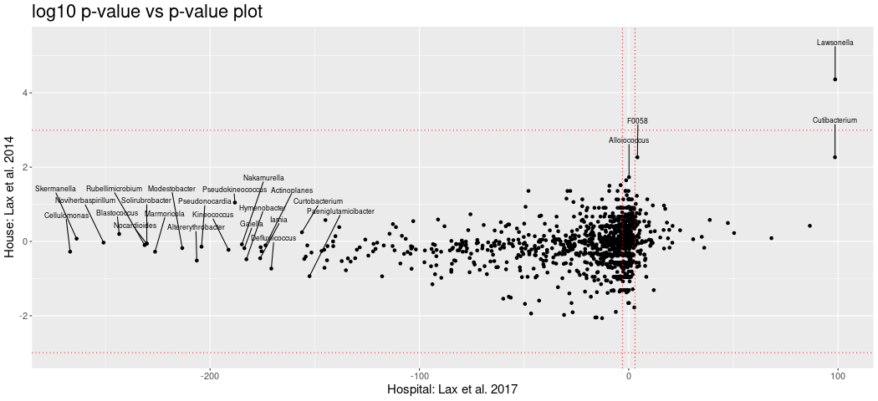
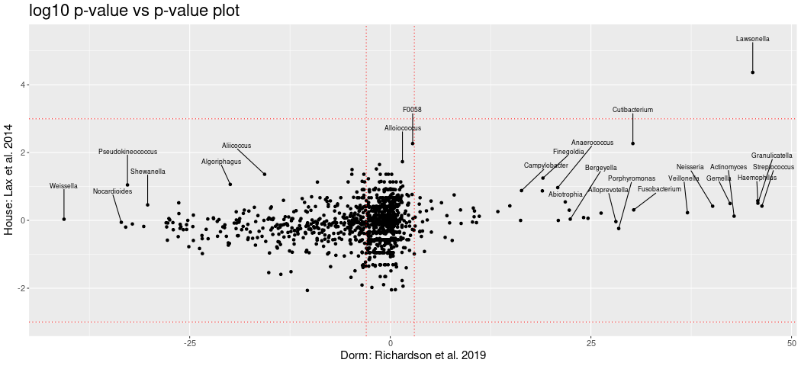
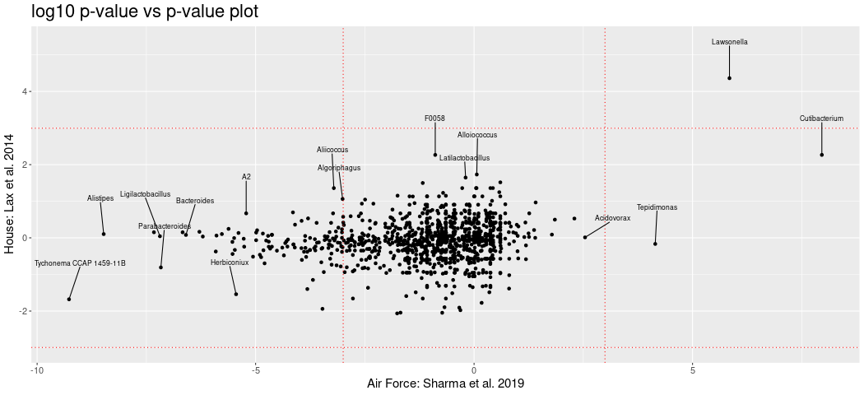
Dataset with smallest sample size does not show strong reproducibility
Notes:
- As we can see, comparisons with Lax et al have no large agreement between studies of common bacteria

Slide 19
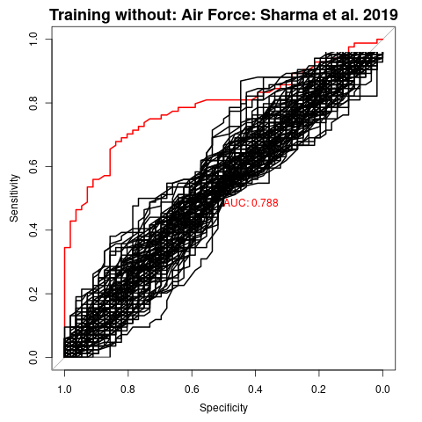
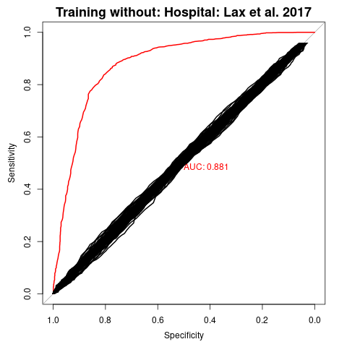
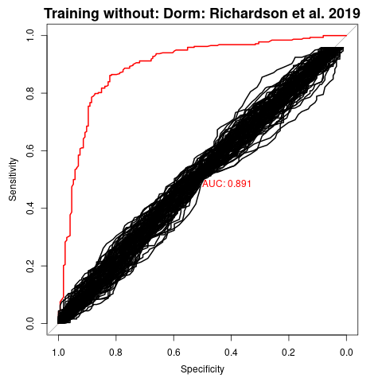
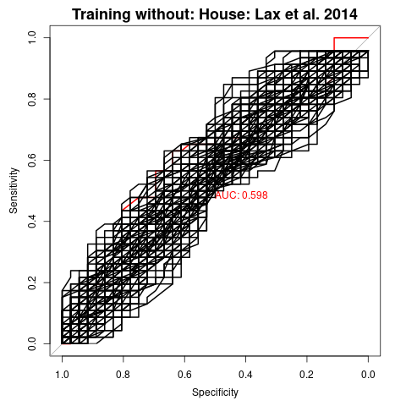
For hand vs floor, three out of four samples showed strong reproducibility

Slide 20
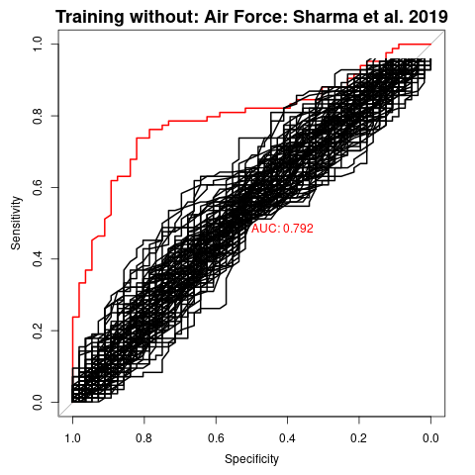
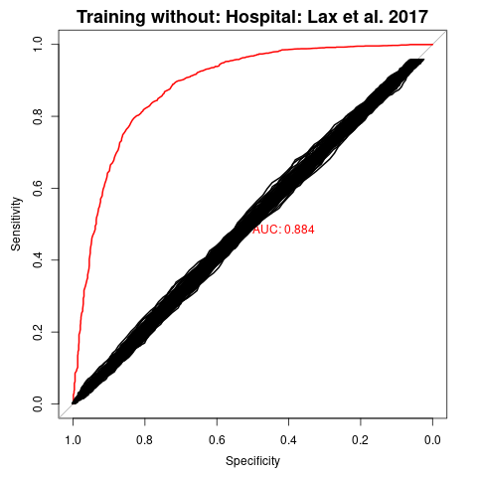
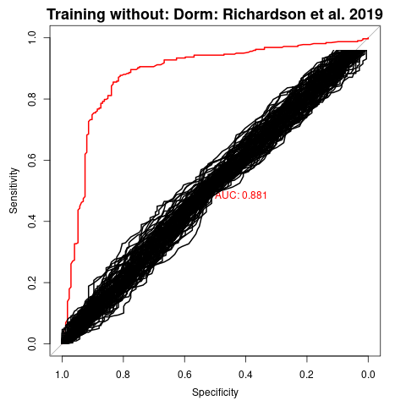
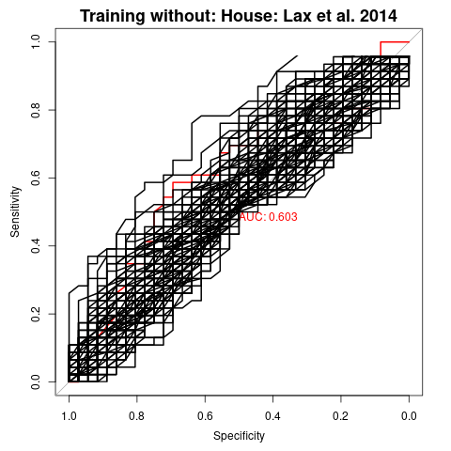
Batch correction does not improve reproducibility
Notes:
We do see that our ROC curves preform worst after adding associated samples

Slide 21
Next Steps
Determine if there is a relationship between sink surfaces which separate them from non-sink surfaces
Determine if there is a relationship between floor and soil samples

